Slide 1

INSTITUTE - UIE
DEPARTMENT- ACADEMIC UNIT-2
Bachelor of Engineering (Computer Science & Engineering)
Subject Name: Basic Data Structure Using C++
Code:23CSH-103
Inheritance
DISCOVER . LEARN . EMPOWER

Slide 2


Basic Data Structure Using C++
Course Objectives
To enable the students to understand various stages and constructs of C++ programming language.
To improve their ability to analyze and address variety of problems in C++.

Slide 3


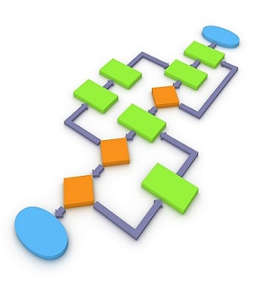
Course Outcomes
CO Number | Course Outcome
CO1 | Understand the concepts of object-oriented programming including programming process and compilation process.
CO2 | Apply different techniques to decompose a problem and programmed a solution with various concepts of object-oriented programming language.
CO3 | Analyse and explain the behaviour of linear data structure operations using the programming addressed in the course.
CO4 | Implement and evaluate the programs using the syntax and semantics of object-oriented programming.
CO5 | Design the solution of real-world problems in order to determine that the program performs as expected.

Slide 4
Scheme of Evaluation
Sr. No. | Type of Assessment Task | Weightage of actual conduct | Frequency of Task | Final Weightage in Internal Assessment (Prorated Marks) | Remarks
1. | Assignment* | 10 marks of each assignment | One Per Unit | 10 marks | As applicable to course types depicted above.
2. | Time Bound Surprise Test | 12 marks for each test | One per Unit | 4 marks | As applicable to course types depicted above.
3. | Quiz | 4 marks of each quiz | 2 per Unit | 4marks | As applicable to course types depicted above.
4. | Mid-Semester Test** | 20 marks for one MST. | 2 per semester | 20 marks | As applicable to course types depicted above.
5. | Presentation*** |  |  | Non Graded: Engagement Task | Only for Self Study MNGCourses.
6. | Homework | NA | One per lecture topic (of 2 questions) | Non-Graded: Engagement Task | As applicable to course types depicted above.
7. | Discussion Forum | NA | One per Chapter | Non Graded: Engagement Task | As applicable to course types depicted above.
8. | Attendance and Engagement Score on BB | NA | NA | 2 marks

Slide 5
CONTENTS
Defining derived class
modes of inheritance
types of inheritance
The capability of a class to derive properties and characteristics from another class is called Inheritance.
Inheritance is one of the most important feature of Object Oriented Programming

Slide 6
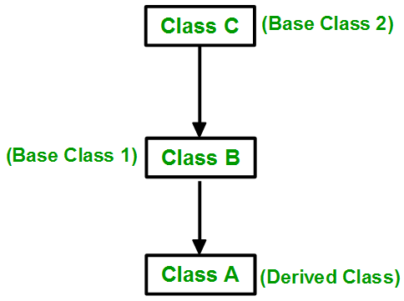
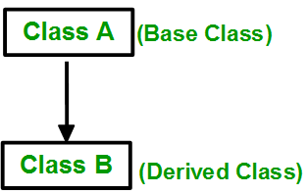
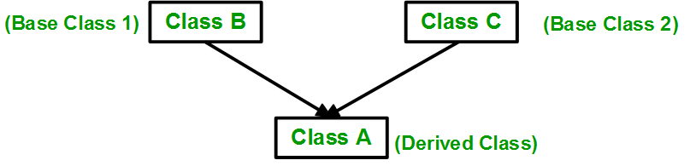
TYPES OF INHERITANCE
1. SINGLE INHERITANCE
3. MULTI-LEVEL INHERITANCE
2. MULTIPLE INHERITANCE
Figure 4.6 Types of inheritance[1]

Slide 7
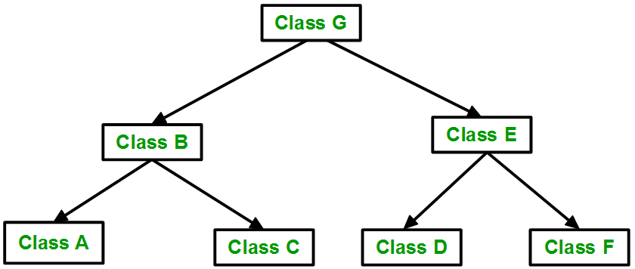
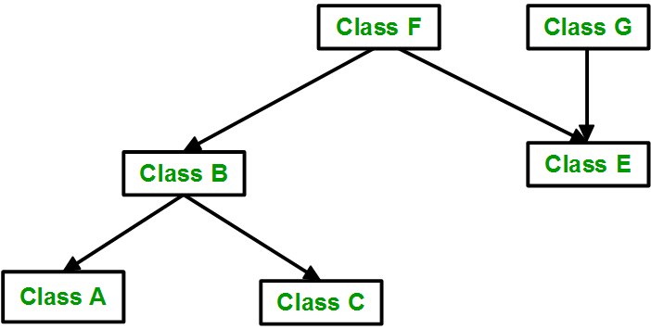
TYPES OF INHERITANCE
5. HYBRID/VIRTUAL INHERITANCE
4. HIERARCHICAL INHERITANCE
Figure 4.7 Types of inheritance[1]

Slide 8
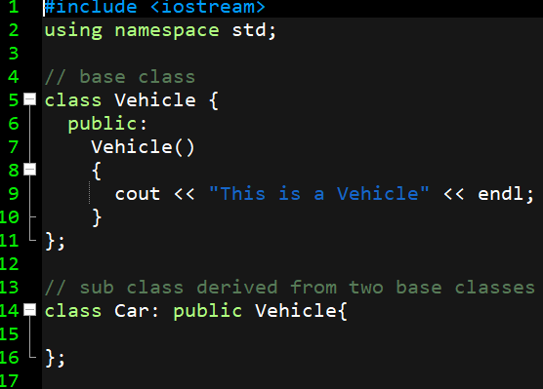
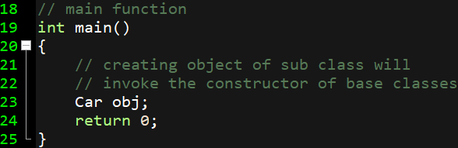
SINGLE INHERITANCE
CLASS
Figure 4.8 Program made on Dev-C++
Notes:
// C++ program to explain
// Single inheritance
#include <iostream>
using namespace std;
// base class
class Vehicle {
public:
Vehicle()
{
cout << "This is a Vehicle" << endl;
}
};
// sub class derived from two base classes
class Car: public Vehicle{
};
// main function
int main()
{
// creating object of sub class will
// invoke the constructor of base classes
Car obj;
return 0;
}

Slide 9
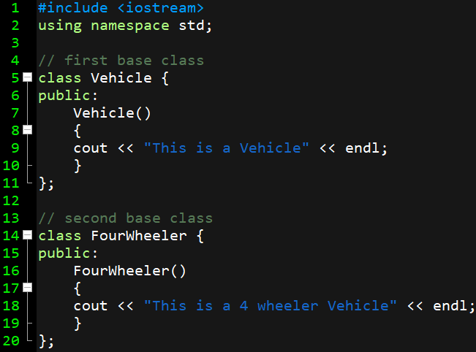
MULTIPLE INHERITANCE
CLASS
Figure 4.8 Program made on Dev-C++
Notes:
// C++ program to explain
// Single inheritance
#include <iostream>
using namespace std;
// base class
class Vehicle {
public:
Vehicle()
{
cout << "This is a Vehicle" << endl;
}
};
// sub class derived from two base classes
class Car: public Vehicle{
};
// main function
int main()
{
// creating object of sub class will
// invoke the constructor of base classes
Car obj;
return 0;
}

Slide 10
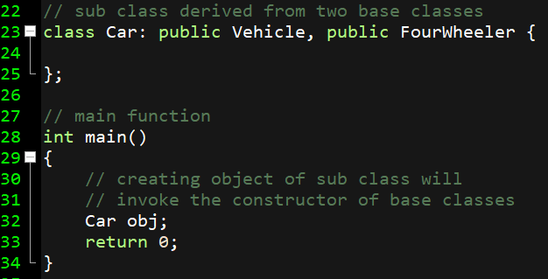
MULTIPLE INHERITANCE
CLASS
Figure 4.8 Program made on Dev-C++
Notes:
// C++ program to explain
// Single inheritance
#include <iostream>
using namespace std;
// base class
class Vehicle {
public:
Vehicle()
{
cout << "This is a Vehicle" << endl;
}
};
// sub class derived from two base classes
class Car: public Vehicle{
};
// main function
int main()
{
// creating object of sub class will
// invoke the constructor of base classes
Car obj;
return 0;
}

Slide 11
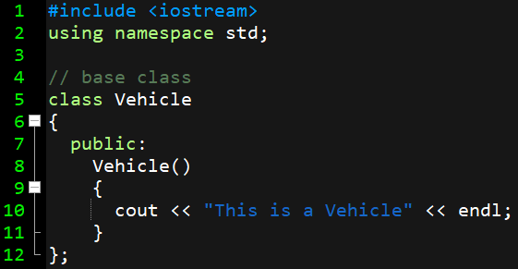
MULTILEVEL INHERITANCE
Figure 4.9 Program made on Dev-C++

Slide 12
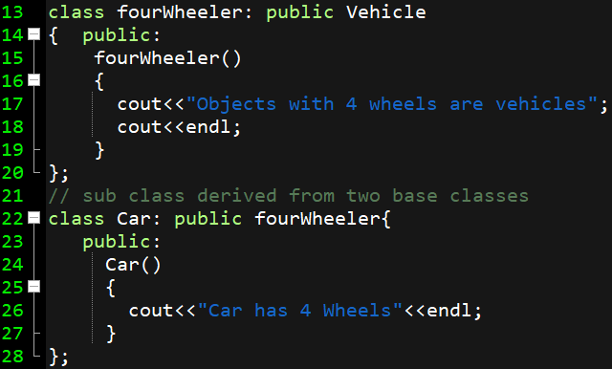
MULTILEVEL INHERITANCE
Figure 4.10 Program made on Dev-C++

Slide 13
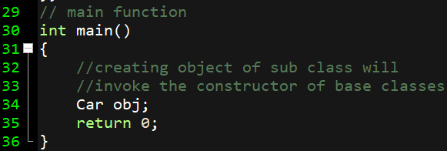
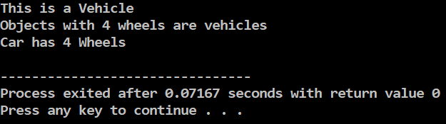
MULTILEVEL INHERITANCE
Figure 4.10 Program made on Dev-C++

Slide 14
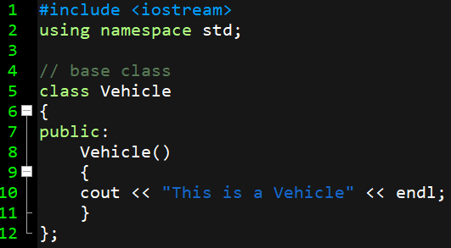
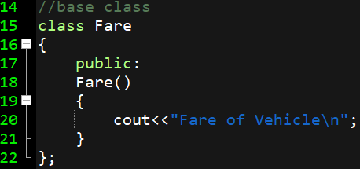
HYBRID INHERITANCE
Figure 4.14 Program made on Dev-C++
Notes:
#include <iostream>
using namespace std;
// base class
class Vehicle
{
public:
Vehicle()
{
cout << "This is a Vehicle" << endl;
}
};
//base class
class Fare
{
public:
Fare()
{
cout<<"Fare of Vehicle\n";
}
};
// first sub class
class Car: public Vehicle
{
};
// second sub class
class Bus: public Vehicle, public Fare
{
};
// main function
int main()
{
// creating object of sub class will
// invoke the constructor of base class
Bus obj2;
return 0;
}

Slide 15
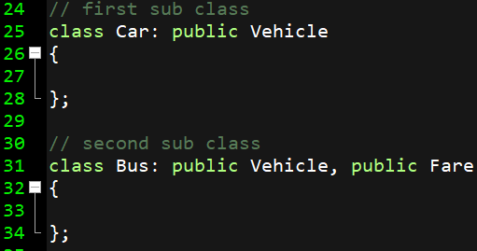
HYBRID INHERITANCE
Figure 4.15 Program made on Dev-C++

Slide 16
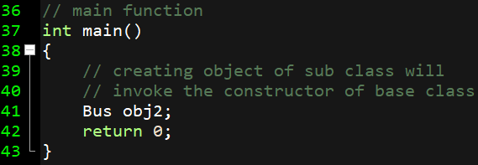
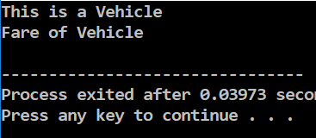
HYBRID INHERITANCE
Figure 4.16 Program made on Dev-C++

Slide 17
Assessment Questions
(a) Define ambiguity in inheritance.
(b) What are modes of inheritance?
(c) What is nesting of classes?
Can we call private constructor? If yes , then how?
Write a C++ program to differentiate between three modes of inheritance.
Write a C++ program to demonstrate hierarchical inheritance.

Slide 18
APPLICATIONS
You use nested classes to reflect and to enforce the relationship between two classes. You should define a class within another class when the nested class makes sense only in the context of its enclosing class or when it relies on the enclosing class for its function. For example, a text cursor might make sense only in the context of a text component.

Slide 19
Frequently Asked Questions: -
Is inheritance important to C++?
When would I use inheritance?
How do you express inheritance in C++?
Is it okay to convert a pointer from a derived class to its base class?
What’s the difference between public, private, and protected?
Why can’t my derived class access private things from my base class?
How can I protect derived classes from breaking when I change the internal parts of the base class?
I’ve been told to never use protected data, and instead to always use private data with protected access functions. Is that a good rule?
Okay, so exactly how should I decide whether to build a “protected interface”?

Slide 20
SUMMARY
Inheritance is the mechanism of deriving new class from an existing class. The old class and new class is known as in pair : super-sub, base-derived, parent-child.
Inheritance provides the idea of reusability. Code once written can be used again and again in several different classes.
C++ provides support for: single level and multilevel inheritance, multiple inheritance, hierarchical inheritance, hybrid inheritance.
Private members are never inherited.
Virtual base class is used to avoid duplicity of data members into the target derived class.

Slide 21
SUMMARY (Continued)
In an inheritance hierarchy constructor of base class is called first, then constructor of derived class is called.
In an inheritance hierarchy destructor class is called first, then destructor of base class is called.
Containership allows us to use object of one class as a member of other class. This type of containership provides the idea of has a relationship or nesting of classes.

Slide 22

REFERENCES
Reference Website
[1] https://www.geeksforgeeks.org/inheritance-in-c/
[2] https://www.geeksforgeeks.org/object-oriented-programming-in-cpp/
[3] https://www.geeksforgeeks.org/copy-constructor-argument-const/
[4] https://en.cppreference.com/w/cpp/language/nested_types
References on YouTubes
[1] https://www.youtube.com/watch?v=rr7HVs4d1Qo
[2] https://www.youtube.com/watch?v=5pJyKzON8Ww
[3] https://www.youtube.com/watch?v=RO1ZYW9NAzg
References books
[1] Object-Oriented Programming in C++, by Robert Lafore
[2] Object-Oriented Programming Using C++, by Joyce Farrell
[3] Object-Oriented Programming Using C++, by Pohl

Slide 23
THANK YOU

